Slide 1
Team 6
Create a web application that improves the efficiency of registering and tracking spontaneous volunteers by management during each disaster

Slide 2
Our Task
Website
Database
QR code
Better user experience
2. Mobile use
3. Scalability
4. Security
5. Unique identity for each volunteer
6. Track where everyone is anytime
Notes:
1. Better user experience- reduce processes, user friendly mobile website
2. Mobile use- Again easier user experience
3.
4. Security- We had to improve the security from a google form storing potentially sensitive information and did so using a password protected database
5. Unique identity for each volunteer- achieved using a QR code assigned to each spolunteer armband
6.Track where everyone is anytime- the QR code generates a unique spolunteer number for each spolunteer which is stored in the database. Managers can filter the database throughout the day to view the availability of spolunteers which is updated throughout the day using their QR code armband

Slide 3
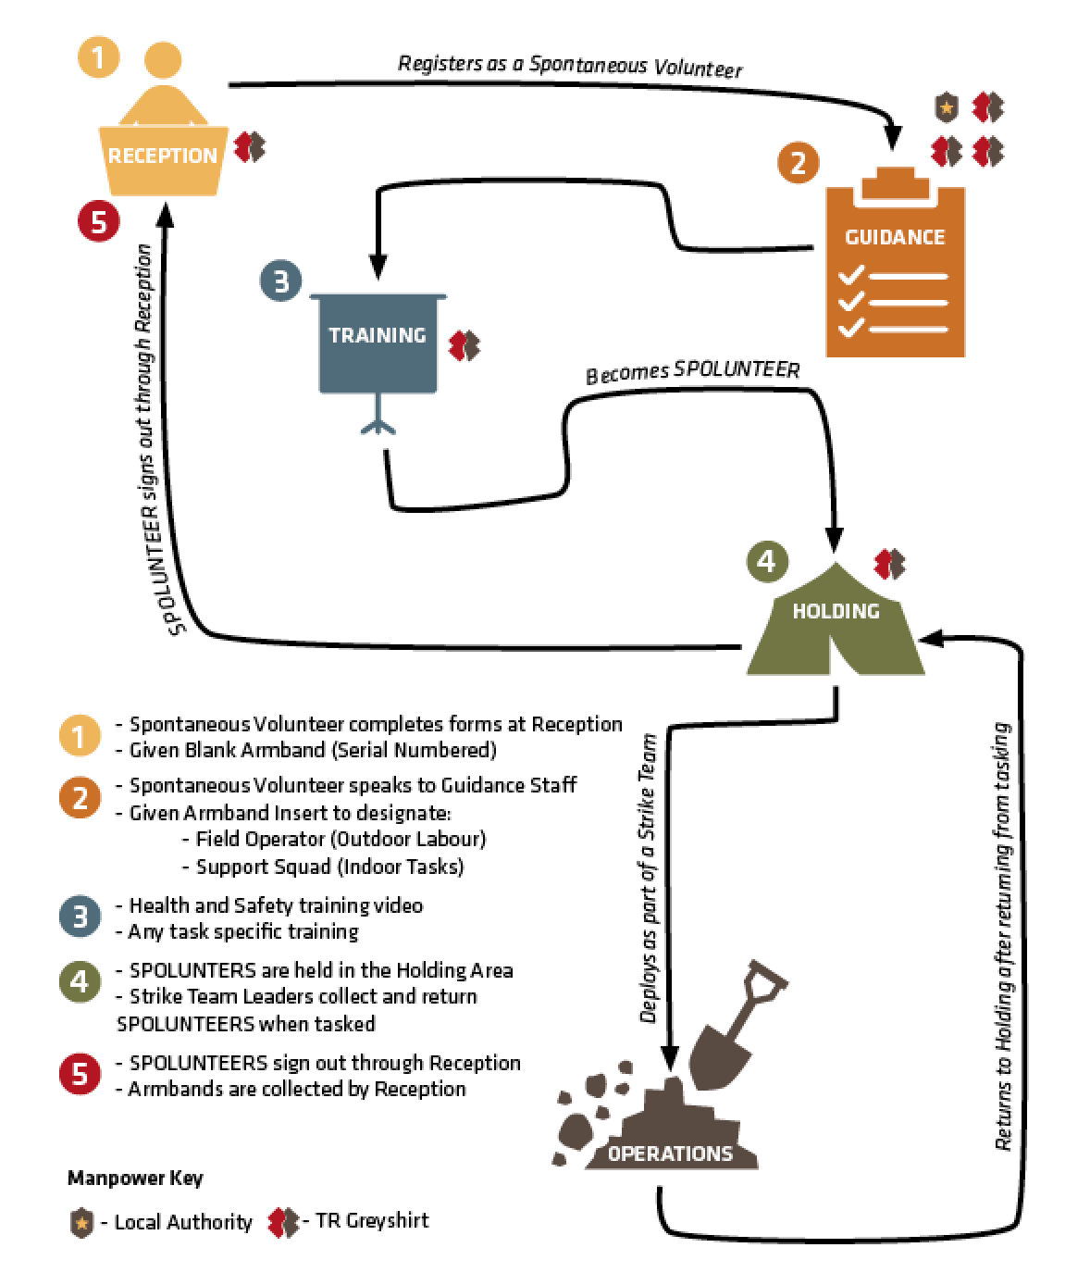
How have we improved the process?
Sign up en route to or at venue
Collect arm band scanned linked to
QR code
Manager scans arm band and pulls up the skills listed by spolunteer to discuss and tick/reject in database
Training is completed via online videos as much as possible in reception
Manager queries which volunteers are free by filtering the spolunteers with a spolunteer number but no workforce holding no.
Spolunteers sign out by returning arm band and scanning the QR code. Spolunteer can indicate their future availability and feedback via the website
Notes:
1. Spolunteers sign up to volunteer via a mobile friendly web application. On arrival they can be identified by their email address and assigned a unique spolunteer number by a unique QR code. The spolunteer number is stored in the database and is used to track the availibility of spolunteers throughout the day.

Slide 4
What technology have we used?
Sign up is made via a mobile friendly website using ……. Because….
Information is stored in a database made using mysql because…
QR code is generated using…..
Notes:
For each point say why that technology was used- how did it improve efficiency?

Slide 5
Website

Slide 6
Database
Created using mysql
Created two tables
Spolunteer information
Tracking information to be linked with QR code
Spolunteer Number | Workforce holding
159 (given by QR code) | Alpha
232

Slide 7
QR Code

